Slide 1

ECE 281 Lesson 11
Maj Jeffrey Falkinburg USAFA/DFEC
Room 2E46E 333-9193
1

Slide 2
Lesson 14 Outline
Do Time Logs!
SR Latch
D Latch
D Flip Flop
Register

Slide 3
Synchronous Circuits
Introduction to Synchronous Circuits
Combinational Logic – Outputs depend on current inputs
Sequential Logic – Outputs depend on current and prior inputs
→ i.e. has memory

Slide 4
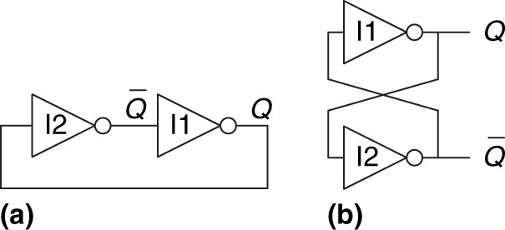
Cross Coupled Inverter
Figure 3.1 Cross-coupled inverter pair
Copyright © 2013 Elsevier Inc. All rights reserved.

Slide 5
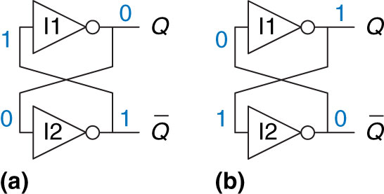
Cross Coupled Inverter
Figure 3.2 Bistable operation of cross-coupled inverters
Copyright © 2013 Elsevier Inc. All rights reserved.

Slide 6
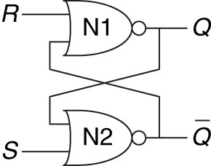
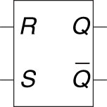
SR Latch
Simplest Sequential Circuit
Figure 3.6 SR latch symbol
Figure 3.3 SR latch schematic
Copyright © 2013 Elsevier Inc. All rights reserved.

Slide 7
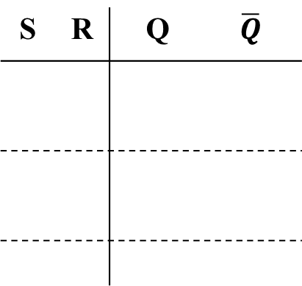
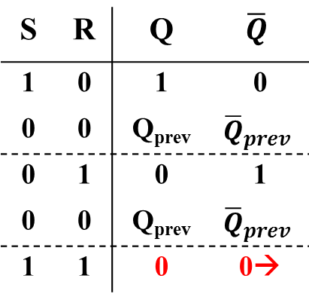
SR Latch
Simplest Sequential Circuit
S = Set
R = Reset
Q = Stored Value
Q changes whenever an input changes
➔ Undefined…next state unknown
S | R | Q | $$\overline{Q}$$
S | R | Q | $$\overline{Q}$$
1 | 0 | 1 | 0
0 | 0 | Q_{prev} | $${\overline{Q}}_{prev}$$
0 | 1 | 0 | 1
0 | 0 | Q_{prev} | $${\overline{Q}}_{prev}$$
1 | 1 | 0 | 0→
Figure 3.3 SR latch schematic
Problem with SR latch: Biggest problem is when S + R are both 1
Copyright © 2013 Elsevier Inc. All rights reserved.

Slide 8
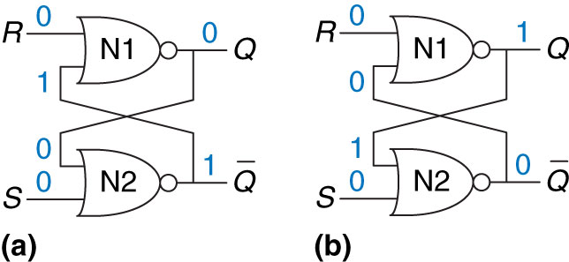
SR Latch
Figure 3.4 Bistable states of SR latch
Copyright © 2013 Elsevier Inc. All rights reserved.

Slide 9
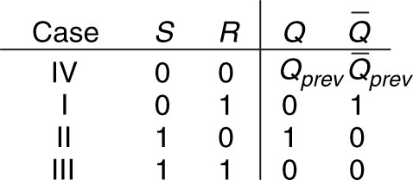
SR Latch
Figure 3.5 SR latch truth table
Copyright © 2013 Elsevier Inc. All rights reserved.

Slide 10
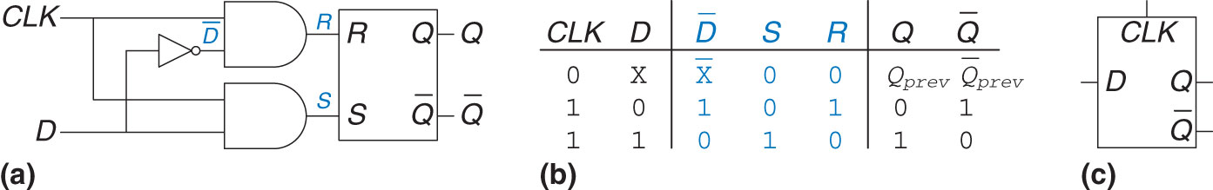
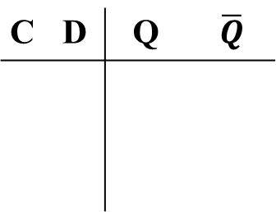
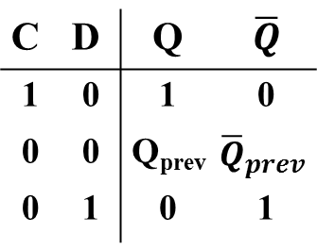
D-Latch
Solves the problem of the SR Latch when both S & R are asserted
C = Control/Clock
D = Data
Q = Stored value
Q changes whenever C is high and D changes
Problem?
C | D | Q | $$\overline{Q}$$
C | D | Q | $$\overline{Q}$$
1 | 0 | 1 | 0
0 | 0 | Q_{prev} | $${\overline{Q}}_{prev}$$
0 | 1 | 0 | 1
Figure 3.7 D latch: (a) schematic, (b) truth table, (c) symbol
Problem with D latch: What if we don’t always want D to update?
Copyright © 2013 Elsevier Inc. All rights reserved.

Slide 11
D-Latch
transparent – if C is high, Q will follow input (D) (i.e. D flows through)
opaque – if C is low, Q won’t change (i.e. D doesn’t flow through)
Figure 3.7 D latch: (a) schematic, (b) truth table, (c) symbol
Copyright © 2013 Elsevier Inc. All rights reserved.

Slide 12
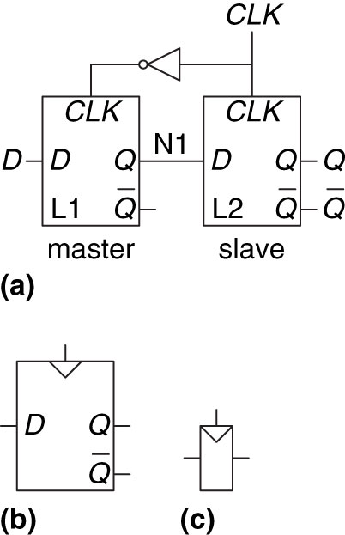
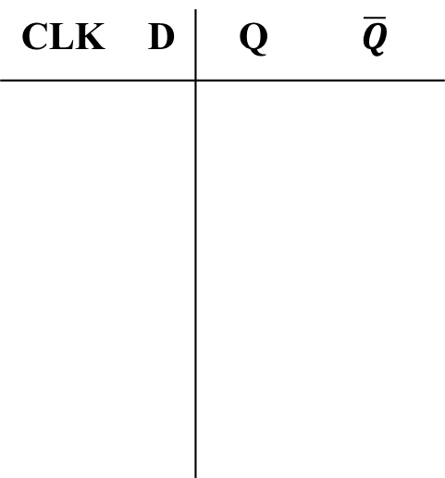
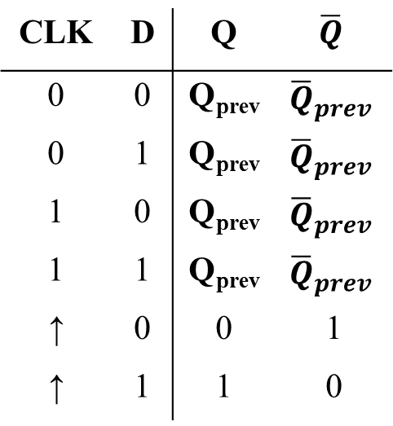
D-Flip Flop
D Flip-Flop – Two D-Latches back to back with complementary clocks in a Master/Slave Configuration
CLK = Clock
D = Data
Q = Stored Value
CLK | D | Q | $$\overline{Q}$$
CLK | D | Q | $$\overline{Q}$$
0 | 0 | Q_{prev} | $${\overline{Q}}_{prev}$$
0 | 1 | Q_{prev} | $${\overline{Q}}_{prev}$$
1 | 0 | Q_{prev} | $${\overline{Q}}_{prev}$$
1 | 1 | Q_{prev} | $${\overline{Q}}_{prev}$$
↑ | 0 | 0 | 1
↑ | 1 | 1 | 0
Figure 3.8 D flip-flop: (a) schematic, (b) symbol, (c) condensed symbol
Copyright © 2013 Elsevier Inc. All rights reserved.

Slide 13
D-Flip Flop
→Called an edge-trigged device
Q changes when clock changes
Enabled flip-flop – Add EN signal to determine if data will load on edge
Resettable flip-flop – resets output to 0 when reset enabled. Useful for hearing known states
Figure 3.8 D flip-flop: (a) schematic, (b) symbol, (c) condensed symbol
Copyright © 2013 Elsevier Inc. All rights reserved.

Slide 14
D-Flip Flop vs D-Latch
*What is the difference between a latch and a flip flop?
A Flip Flop changes on the clock edge a latch changes at any time
D-Latch updates it’s state continuously while clk = ‘1’
Copies D → Q on Rising Edge of Clock and remembers it’s state on all others

Slide 15
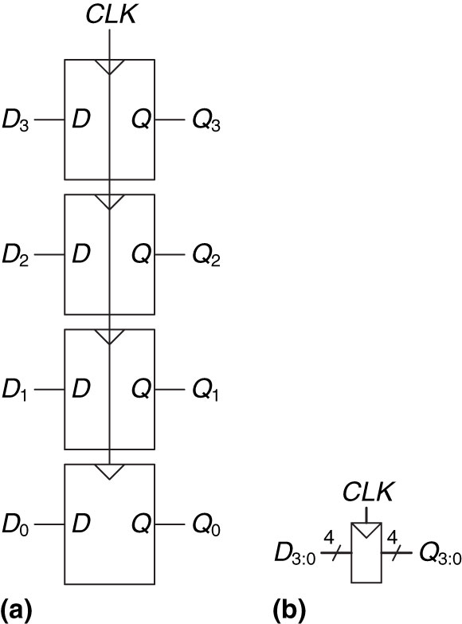
Register
Register
An N-Bit Register is a Bank of N-Flip Flops
Figure 3.9 A 4-bit register: (a) schematic and (b) symbol
Copyright © 2013 Elsevier Inc. All rights reserved.

Slide 16
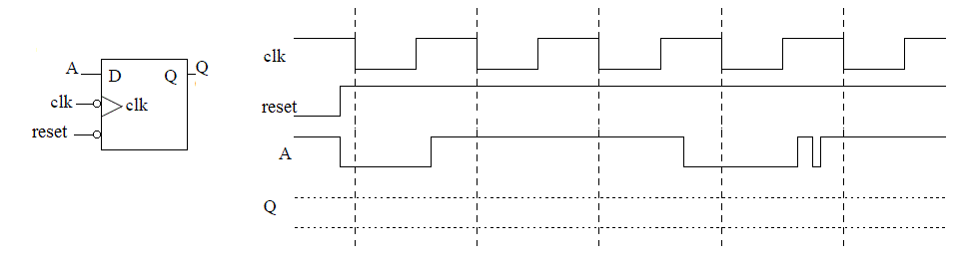
Example Waveform
FF
Latch

Slide 17
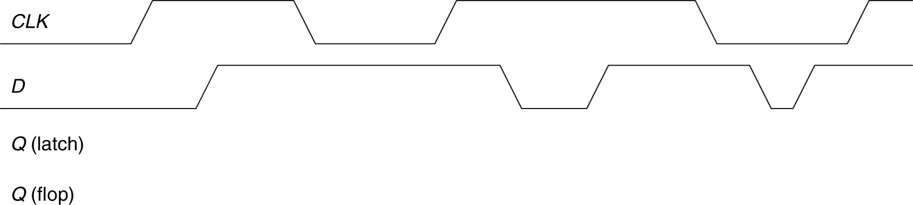
Example Waveform
Figure 3.14 Example waveforms
Copyright © 2013 Elsevier Inc. All rights reserved.

Slide 18
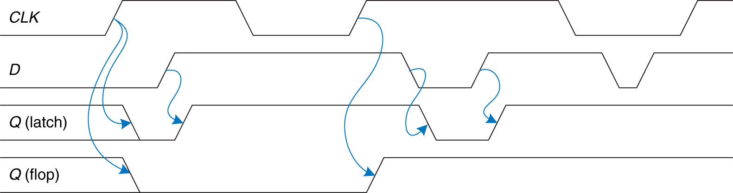
Example Waveform
Figure 3.15 Solution waveforms
Copyright © 2013 Elsevier Inc. All rights reserved.

Slide 19
Synchronous Circuit Properties
Synchronous circuit – Combinational circuit followed by bank of flip flops
Properties:
Each element is either a register or a combinational circuit
At least one circuit is a register
All registers have the same clock
Every cyclic path contains at least one register
Example: FSMs, Pipelines
Asynchronous circuit – Timing not limited by clock registers

Slide 20
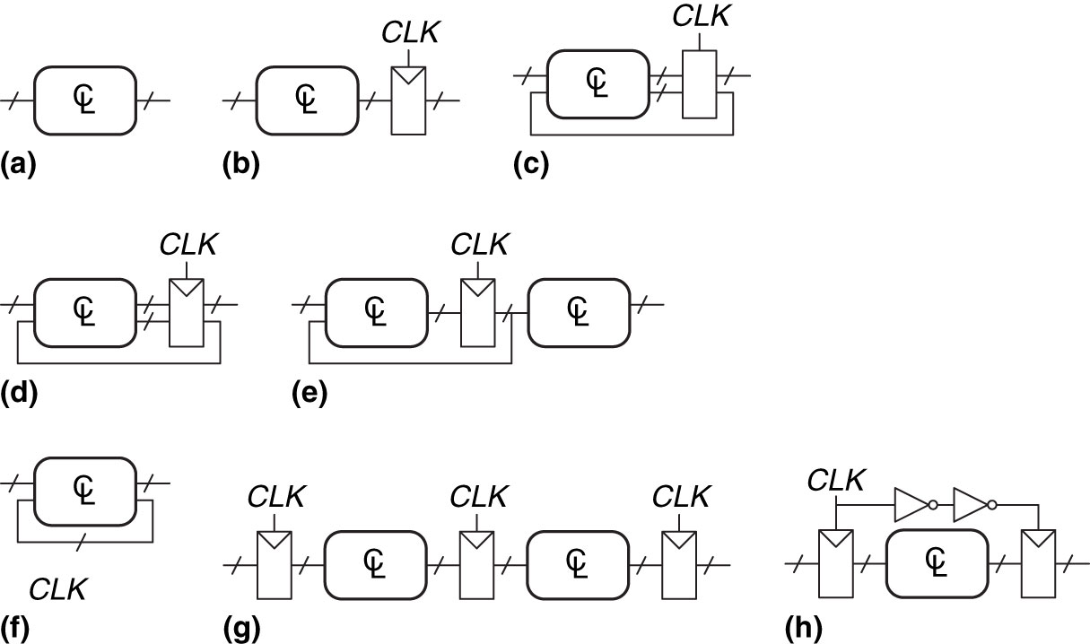
Examples of Circuits
Example 3.5: Synchronous Sequential Circuits
Figure 3.21 Example circuits
Copyright © 2013 Elsevier Inc. All rights reserved.

Slide 21
Extra Instruction (EI)
Maj Jeffrey Falkinburg
2E46E
Office: 333-9193
M1
ECE 281 – 2F44
T1
M2
ECE 281 – 2F44
T2
M3
ECE 463 – 2G2
T3
ECE 383 – 2E48A
M4
ECE 463 – 2G2
T4
ECE 383 – 2E48A
Available
M5
T5
Sometimes Available
M6
ECE 383 – 2E48A
T6
Always Unavailable
M7
ECE 383 – 2E48A
T7

Slide 22

22

